Slide 1









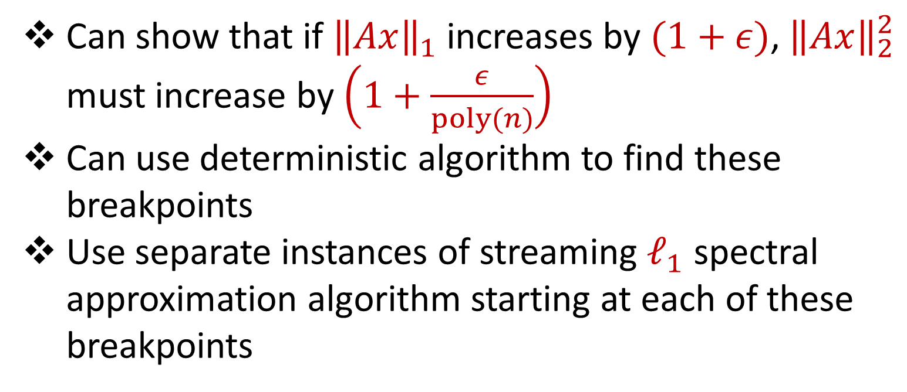
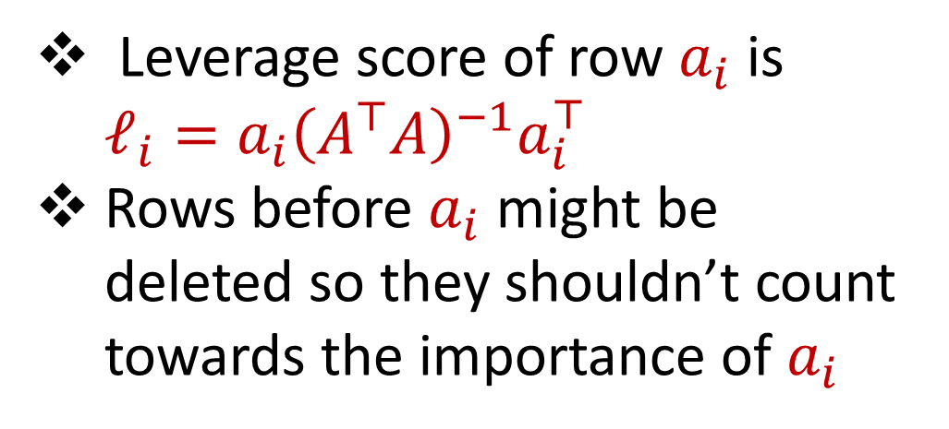
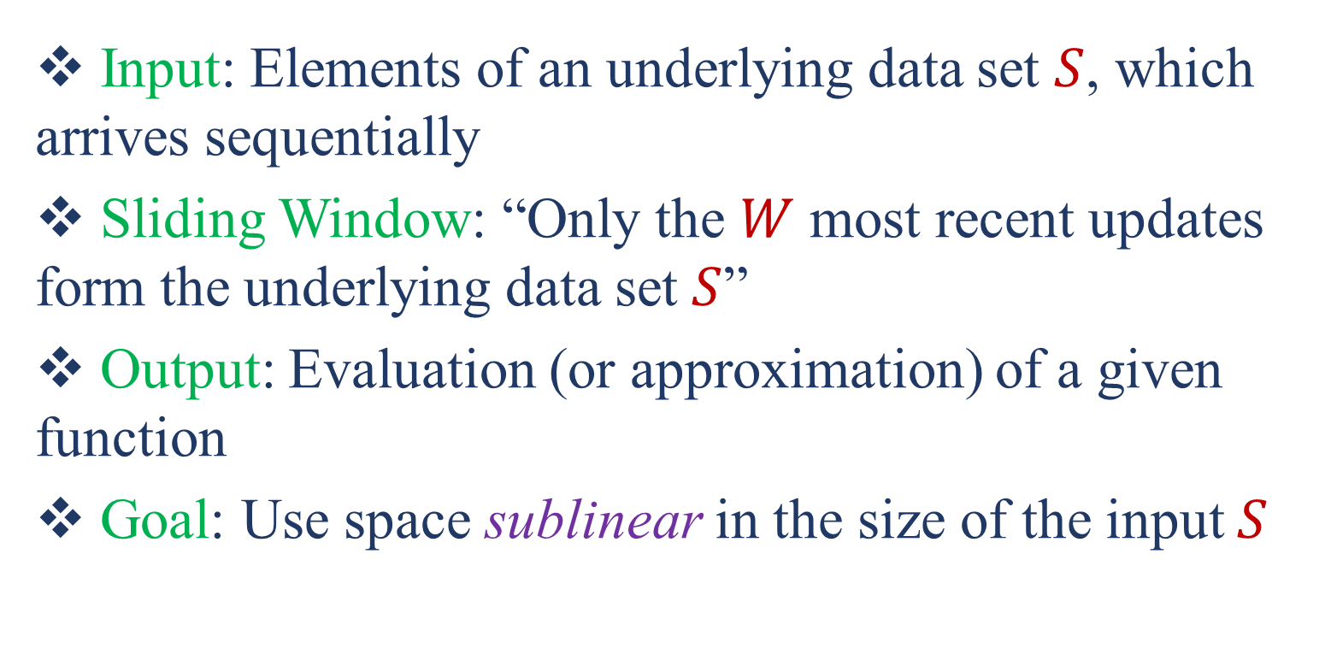

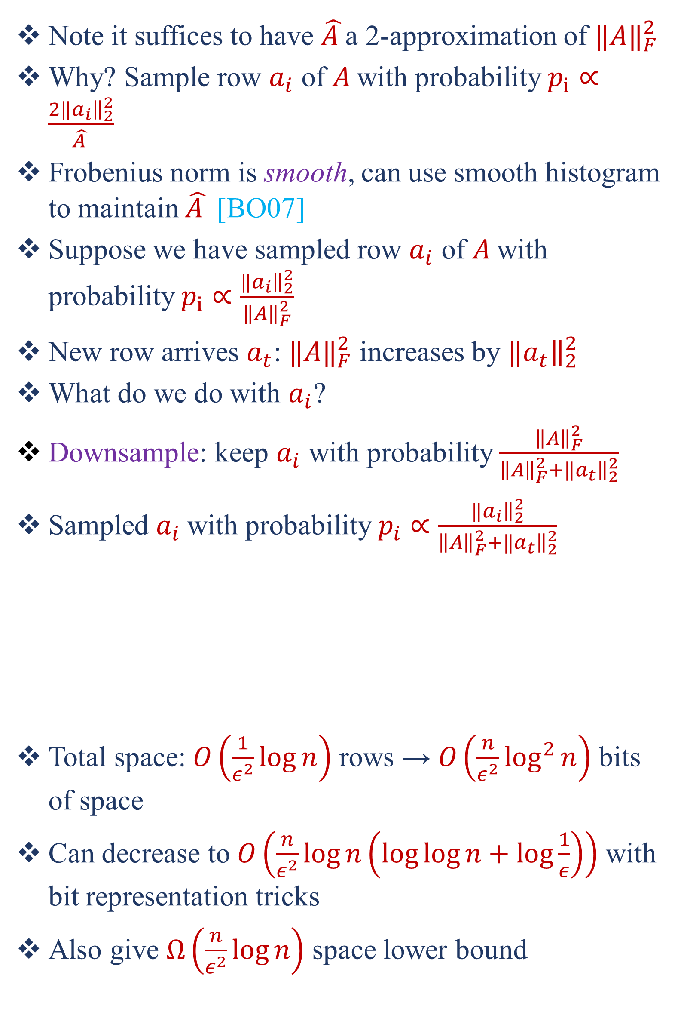
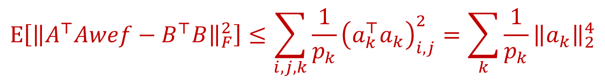
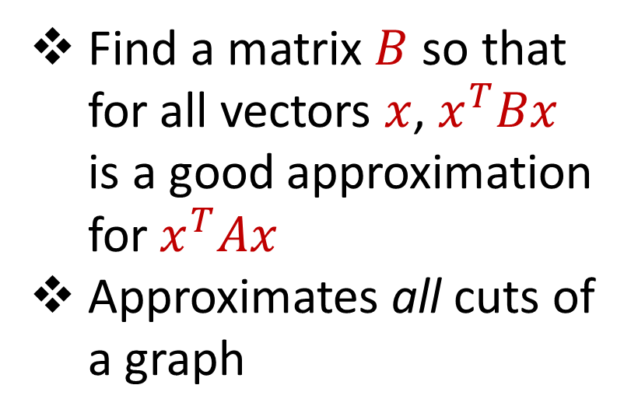

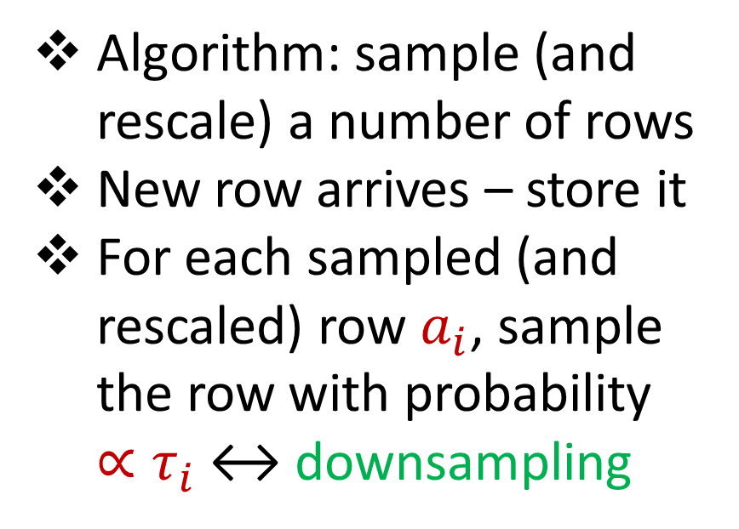
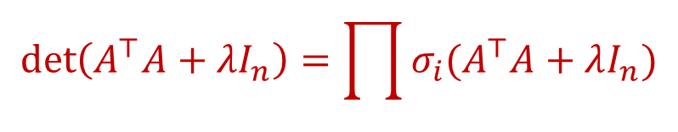
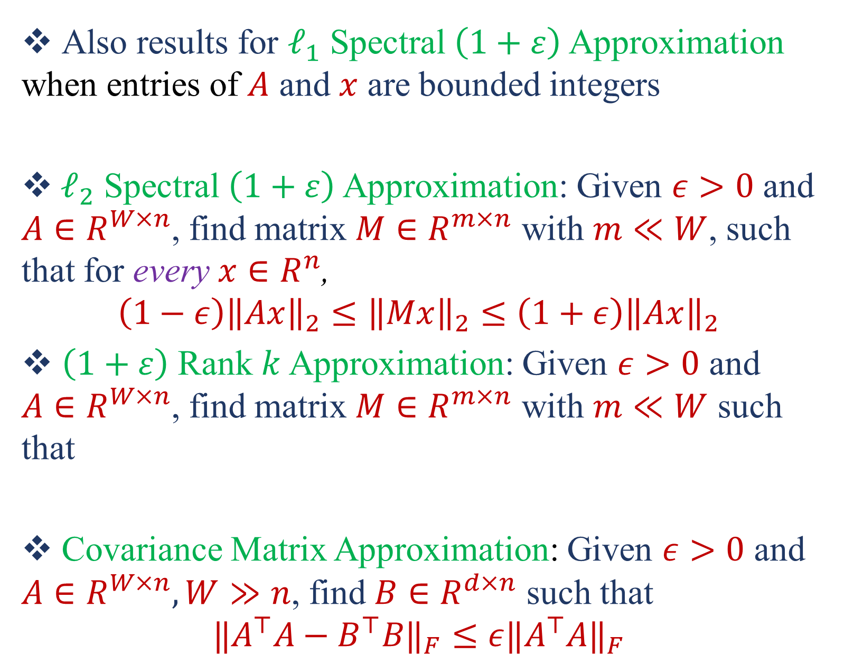


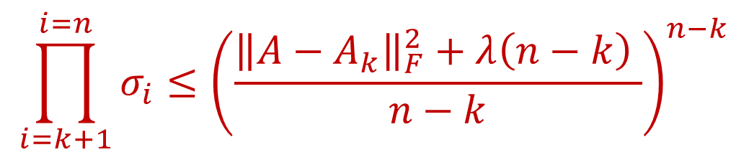
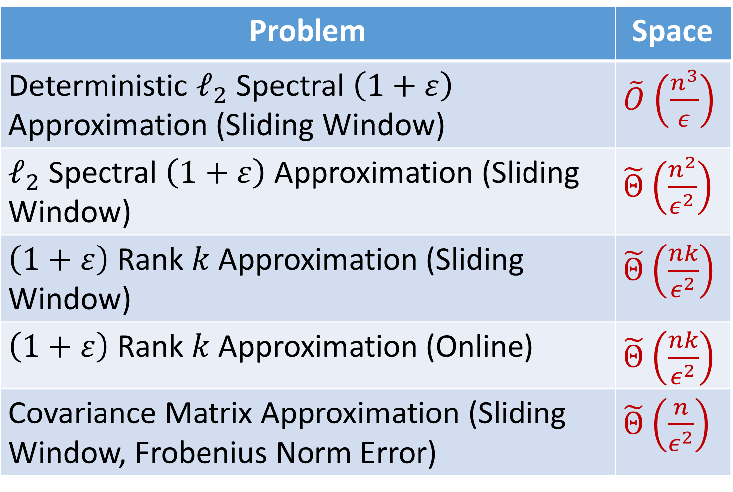
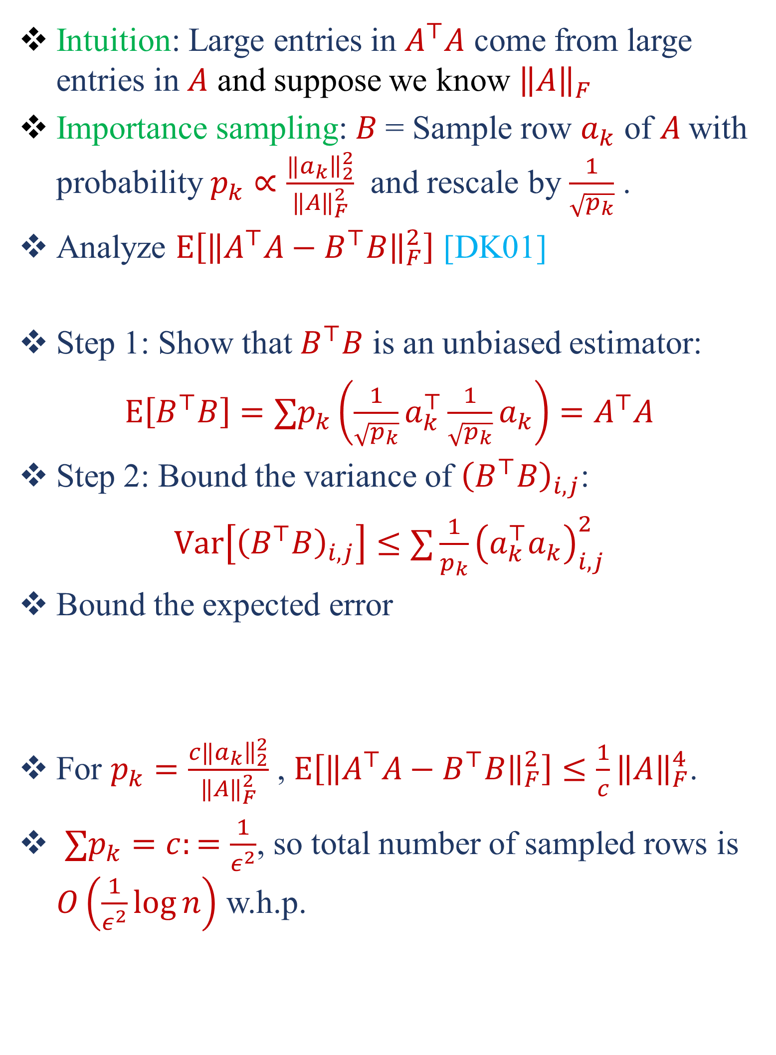
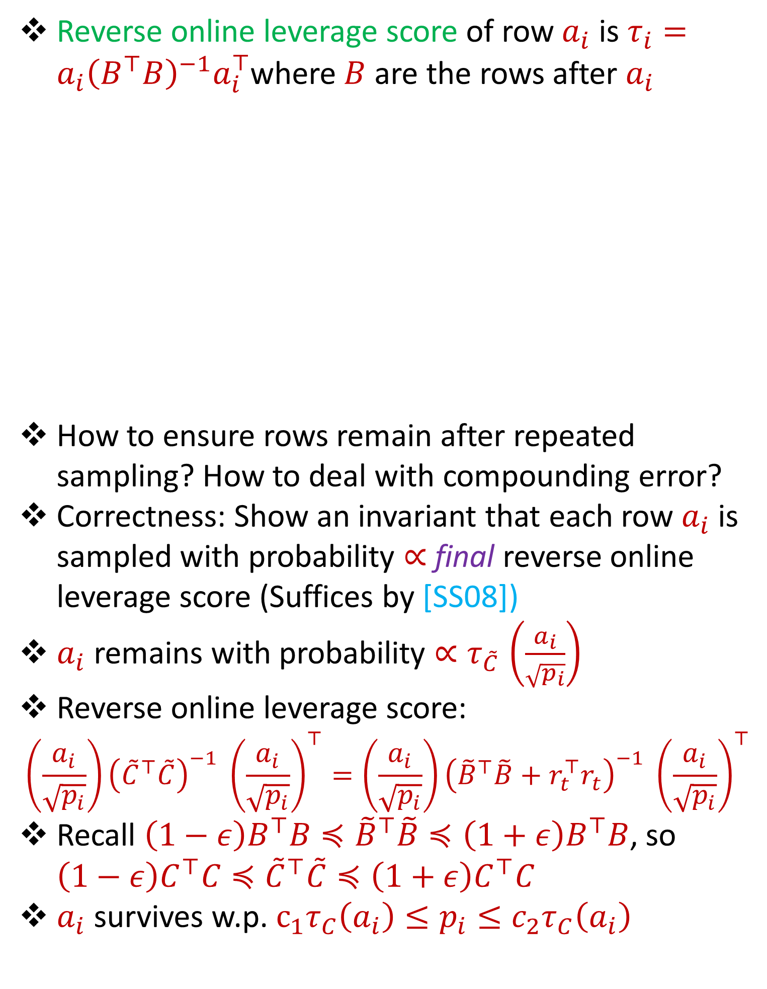
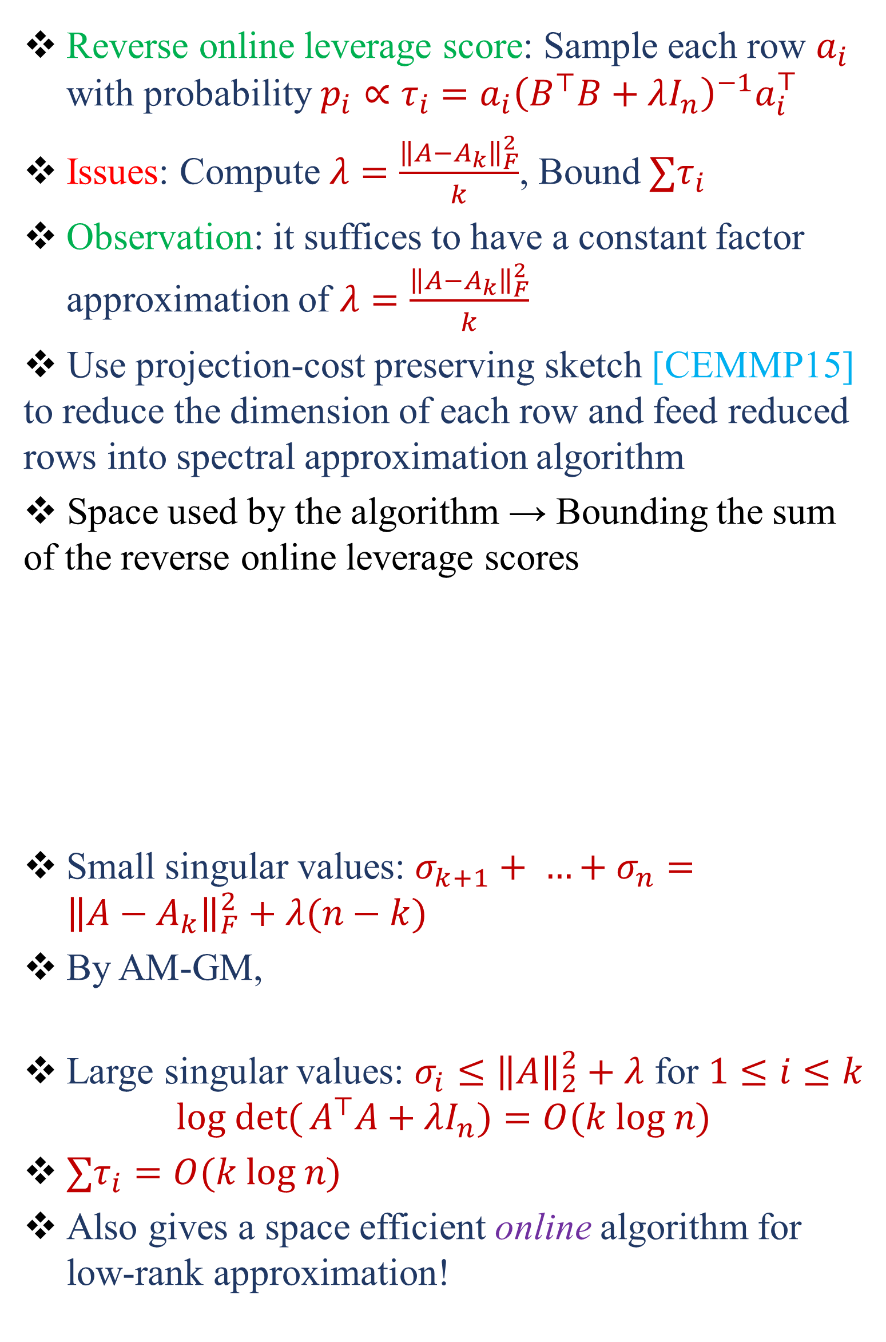
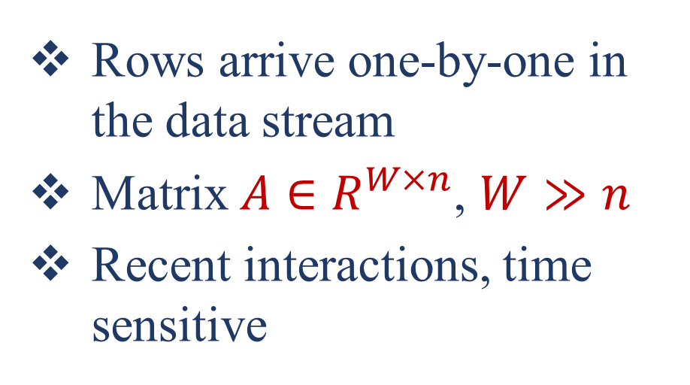




Numerical Linear Algebra in the Sliding Window Model
Vladimir Braverman¹, Petros Drineas², Jalaj Upadhyay¹, David P. Woodruff⁴, Samson Zhou³
¹Johns Hopkins University, ²Purdue University, ³Carnegie Mellon University, ⁴Indiana University
samsonzhou@gmail.com
PRELIMINARIES
APPROXIMATE MATRIX MULTIPLICATION
$ℓ_{2}$ SPECTRAL APPROXIMATION
LOW-RANK APPROXIMATION
Input: Elements of an underlying data set $S$, which arrives sequentially
Sliding Window: “Only the $W$ most recent updates form the underlying data set $S$”
Output: Evaluation (or approximation) of a given function
Goal: Use space sublinear in the size of the input $S$
Intuition: Large entries in $A^{⊤}A$ come from large entries in $A$ and suppose we know ${\left\|A\right\|}_{F}$
Importance sampling: $B$= Sample row $a_{k}$ of $A$with probability $p_{k}∝\frac{{‖a}_{k}{\left.​\right\|}_{2}^{2}}{{‖A‖}_{F}^{2}}$ and rescale by $\frac{1}{\sqrt{p_{k}}}$ .
Analyze $E\left[{\left\|A^{⊤}A−B^{⊤}B\right\|}_{F}^{2}\right]$ [DK01]
Step 1: Show that $B^{⊤}B$ is an unbiased estimator:
$E\left[B^{⊤}B\right]=∑p_{k}\left(\frac{1}{\sqrt{p_{k}}}a_{k}^{⊤}\frac{1}{\sqrt{p_{k}}}a_{k}\right)=A^{⊤}A$
Step 2: Bound the variance of ${\left(B^{⊤}B\right)}_{i,j}$:
$Var\left[{\left(B^{⊤}B\right)}_{i,j}\right]≤∑\frac{1}{p_{k}}{\left(a_{k}^{⊤}a_{k}\right)}_{i,j}^{2}$
Bound the expected error
For $p_{k}=\frac{c{‖a}_{k}{\left.​\right\|}_{2}^{2}}{{‖A‖}_{F}^{2}}$ , $E\left[{\left\|A^{⊤}A−B^{⊤}B\right\|}_{F}^{2}\right]≤\frac{1}{c}{\left\|A\right\|}_{F}^{4}$.
${∑p}_{k}=c:=\frac{1}{ε^{2}}$, so total number of sampled rows is $O\left(\frac{1}{ε^{2}}\log{n}\right)$ w.h.p.
$$x^{T}$$
Find a matrix $B$ so that for all vectors $x$, $x^{T}Bx$ is a good approximation for $x^{T}Ax$
Approximates all cuts of a graph
Reverse online leverage score: Sample each row $a_{i}$ with probability $p_{i}∝τ_{i}$ $=a_{i}{\left(B^{⊤}B+λI_{n}\right)}^{−1}a_{i}^{⊤}$
Issues: Compute $λ=\frac{{\left\|A−A_{k}\right\|}_{F}^{2}}{k}$, Bound ${∑τ}_{i}$
Observation: it suffices to have a constant factor approximation of $λ=\frac{{\left\|A−A_{k}\right\|}_{F}^{2}}{k}$
Use projection-cost preserving sketch [CEMMP15] to reduce the dimension of each row and feed reduced rows into spectral approximation algorithm
Space used by the algorithm → Bounding the sum of the reverse online leverage scores
Small singular values: $σ_{k+1}+ …+σ_{n}={\left\|A−A_{k}\right\|}_{F}^{2}+λ(n−k)$
By AM-GM,
Large singular values: $σ_{i}≤{\left\|A\right\|}_{2}^{2}+λ$ for $1≤i≤k$
$$log det{(}A^{⊤}A+λI_{n})=O(k log n)$$
${∑τ}_{i}=O(k log n)$
Also gives a space efficient online algorithm for low-rank approximation!
$$A$$
$$x$$
$$n$$
Smooth histogram does not work!
Johnson-Lindenstrauss based compression techniques also do not seem to help
Intuition: If we tried to build a histogram, a lot of similar structure between instances: most rows are shared!
Squared row norm sampling does not work!
Leverage score sampling does not work!
1 0 1 1 1 0 0 1 1 0 1
Question:
Are there space efficient algorithms for numerical linear algebra in the sliding window model?
$$\det\left(A^{⊤}A+λI_{n}\right)=\det\left(A_{W−1}^{⊤}A_{W−1}+λI_{n}\right)(1+a_{W}{\left(A_{W−1}^{⊤}A_{W−1}+λI_{n}\right)}^{−1}a_{W}^{⊤})$$
$$=\det\left(A_{W−1}^{⊤}A_{W−1}+λI_{n}\right)(1+τ_{W})$$
1 3 5 -2
0 0 -1 3
2 5 6 1
8 7 2 1
-5 3 -4 -1
7 1 3 2
$$r_{t}$$
We should always store the most recent row
Need a new sense of importance for both recency AND uniqueness of a row
$$≥\det\left(A_{W−1}^{⊤}A_{W−1}+λI_{n}\right)\left(1+e^{τ_{w}/2}\right)$$
Rows arrive one-by-one in the data stream
Matrix $A∈R^{W×n}$, $W≫n$
Recent interactions, time sensitive
$\det\left(A^{⊤}A+λI_{n}\right)≥λ^{n}$ $e^{{∑τ}_{i}/2}$
$$E\left[{\left\|A^{⊤}Awef−B^{⊤}B\right\|}_{F}^{2}\right]≤\sum_{i,j,k}{\frac{1}{p_{k}}{\left(a_{k}^{⊤}a_{k}\right)}_{i,j}^{2}}=\sum_{k}{\frac{1}{p_{k}}{\left\|a_{k}\right\|}_{2}^{4}}$$
$$0$$
$$A$$
$$\det\left(A^{⊤}A+λI_{n}\right)=\prod{σ_{i}(A^{⊤}A+λI_{n}\text{)}}$$
$$\prod_{i=k+1}^{i=n}{σ_{i}}≤{\left(\frac{{\left\|A−A_{k}\right\|}_{F}^{2}+λ\left(n−k\right) }{n−k}\right)}^{n−k}$$
RESULTS
REVERSE ONLINE LEVERAGE SCORES
Problem | Space
Deterministic $ℓ_{2}$ Spectral $\left(1+ε\right)$ Approximation (Sliding Window) | $\tilde{O}$ $\left(\frac{n^{3}}{ε}\right)$
$ℓ_{2}$ Spectral $\left(1+ε\right)$ Approximation (Sliding Window) | $\tilde{Θ}$ $\left(\frac{n^{2}}{ε^{2}}\right)$
$\left(1+ε\right)$ Rank $k$ Approximation (Sliding Window) | $\tilde{Θ}$ $\left(\frac{nk}{ε^{2}}\right)$
$\left(1+ε\right)$ Rank $k$ Approximation (Online) | $\tilde{Θ}$ $\left(\frac{nk}{ε^{2}}\right)$
Covariance Matrix Approximation (Sliding Window, Frobenius Norm Error) | $\tilde{Θ}$ $\left(\frac{n}{ε^{2}}\right)$
Note it suffices to have $\hat{A }$a 2-approximation of ${‖A‖}_{F}^{2}$
Why? Sample row $a_{i}$ of $A$with probability $p_{i}∝\frac{2{‖a}_{i}{\left.​\right\|}_{2}^{2}}{\hat{A }}$
Frobenius norm is smooth, can use smooth histogram to maintain $\hat{A }$ [BO07]
Suppose we have sampled row $a_{i}$ of $A$with probability $p_{i}∝\frac{{‖a}_{i}{\left.​\right\|}_{2}^{2}}{{‖A‖}_{F}^{2}}$
New row arrives $a_{t}$: ${‖A‖}_{F}^{2}$ increases by ${‖a}_{t}{\left.​\right\|}_{2}^{2}$
What do we do with $a_{i}$?
Downsample: keep $a_{i}$ with probability $\frac{{\left\|A\right\|}_{F}^{2}}{{\left\|A\right\|}_{F}^{2}+{‖a}_{t}{\left.​\right\|}_{2}^{2}}$
Sampled $a_{i}$with probability $p_{i}∝\frac{{‖a}_{i}{\left.​\right\|}_{2}^{2}}{{\left\|A\right\|}_{F}^{2}+{‖a}_{t}{\left.​\right\|}_{2}^{2}}$
Total space: $O\left(\frac{1}{ε^{2}}\log{n}\right)$ rows → $O\left(\frac{n}{ε^{2}}\log^{2}{n}\right)$ bits of space
Can decrease to $O\left(\frac{n}{ε^{2}}\log{n\left(\log{\log{n+\log{\frac{1}{ε}}}}\right)}\right)$ with bit representation tricks
Also give $Ω\left(\frac{n}{ε^{2}}\log{n}\right)$ space lower bound
$$A$$
Leverage score of row $a_{i}$ is $ℓ_{i}=a_{i}{\left(A^{⊤}A\right)}^{−1}a_{i}^{⊤}$
Rows before $a_{i}$ might be deleted so they shouldn’t count towards the importance of $a_{i}$
$$a_{i}$$
$$B$$
$ℓ_{1}$ SPECTRAL APPROXIMATION
Reverse online leverage score of row $a_{i}$ is $τ_{i}=a_{i}{\left(B^{⊤}B\right)}^{−1}a_{i}^{⊤}$where $B$ are the rows after $a_{i}$
How to ensure rows remain after repeated sampling? How to deal with compounding error?
Correctness: Show an invariant that each row $a_{i}$is sampled with probability $∝$ final reverse online leverage score (Suffices by [SS08])
$a_{i}$ remains with probability ${∝τ}_{\tilde{C}}\left(\frac{a_{i}}{\sqrt{p_{i}}}\right)$
Reverse online leverage score:
$$\left(\frac{a_{i}}{\sqrt{p_{i}}}\right){\left({\tilde{C}}^{⊤}\tilde{C}\right)}^{−1} {\left(\frac{a_{i}}{\sqrt{p_{i}}}\right)}^{⊤}=\left(\frac{a_{i}}{\sqrt{p_{i}}}\right){\left({\tilde{B}}^{⊤}\tilde{B}+r_{t}^{⊤}r_{t}\right)}^{−1} {\left(\frac{a_{i}}{\sqrt{p_{i}}}\right)}^{⊤}$$
Recall $\left(1−ε\right)B^{⊤}B≼{\tilde{B}}^{⊤}\tilde{B}≼\left(1+ε\right)B^{⊤}B$, so $\left(1−ε\right)C^{⊤}C≼{\tilde{C}}^{⊤}\tilde{C}≼\left(1+ε\right)C^{⊤}C$
$a_{i}$ survives w.p. $c_{1}τ_{C}\left(a_{i}\right)≤p_{i}≤c_{2}τ_{C}\left(a_{i}\right)$
Can show that if ${\left\|Ax\right\|}_{1}$ increases by $(1+ε)$, ${\left\|Ax\right\|}_{2}^{2}$ must increase by $\left(1+\frac{ε}{poly(n)}\right)$
Can use deterministic algorithm to find these breakpoints
Use separate instances of streaming $ℓ_{1}$ spectral approximation algorithm starting at each of these breakpoints
Algorithm: sample (and rescale) a number of rows
New row arrives – store it
For each sampled (and rescaled) row $a_{i}$, sample the row with probability ${∝τ}_{i}$ ↔ downsampling
$$A$$
$$a_{i}$$
Also results for $ℓ_{1}$ Spectral $\left(1+ε\right)$ Approximation when entries of $A$ and $x$ are bounded integers
$ℓ_{2}$ Spectral $\left(1+ε\right)$ Approximation: Given $ε>0$ and $A∈R^{W×n}$, find matrix $M∈R^{m×n}$ with $m≪W$, such that for every $x∈R^{n}$,
$$\left(1−ε\right){\left\|Ax\right\|}_{2}≤{\left\|Mx\right\|}_{2}≤\left(1+ε\right){\left\|Ax\right\|}_{2}$$
$\left(1+ε\right)$ Rank $k$ Approximation: Given $ε>0$ and $A∈R^{W×n}$, find matrix $M∈R^{m×n}$ with $m≪W$ such that
Covariance Matrix Approximation: Given $ε>0$ and $A∈R^{W×n},W≫n$, find $B∈R^{d×n}$ such that
$${‖A^{⊤}A−B^{⊤}B‖}_{F}≤ε{‖A^{⊤}A‖}_{F}$$
$$\tilde{C}$$
$$\tilde{B}$$
$$B$$
REFERENCES
$$r_{t}$$
[BO07] Vladimir Braverman, Rafail Ostrovsky. Smooth histograms for sliding windows. FOCS 2007
[CEMMP16] Michael B. Cohen, Sam Elder, Cameron Musco, Christopher Musco, and Madalina Persu. Dimensionality reduction for k-means clustering and low rank approximation. STOC 2015
[DK01] Petros Drineas, Ravi Kannan. Fast Monte-Carlo Algorithms for Approximate Matrix Multiplication. FOCS 2001
[SS08] Daniel A. Spielman, Nikhil Srivastava. Graph sparsification by effective resistances. Funda Ergün, Hossein Jowhari, and Mert Saglam. Periodicity in streams. STOC 2008
Separate instance of matrix multiplication streaming algorithm for each instance tracking the Frobenius norm
$$\left(1−ε\right){\left\|A−A_{k}\right\|}_{F}≤{\left\|M−M_{k}\right\|}_{F}≤\left(1+ε\right){\left\|A−A_{k}\right\|}_{F}$$

